Slide 1

Managing your Corporate Master Data Assets
The Benefits of Riversand Master Data Management Solutions
Notes:
This PowerPoint Template includes a series of slide masters with predefined layouts and color schemes for formatting slides
Slide Masters are displayed when you right click on a slide and select Layout from menu

Slide 2
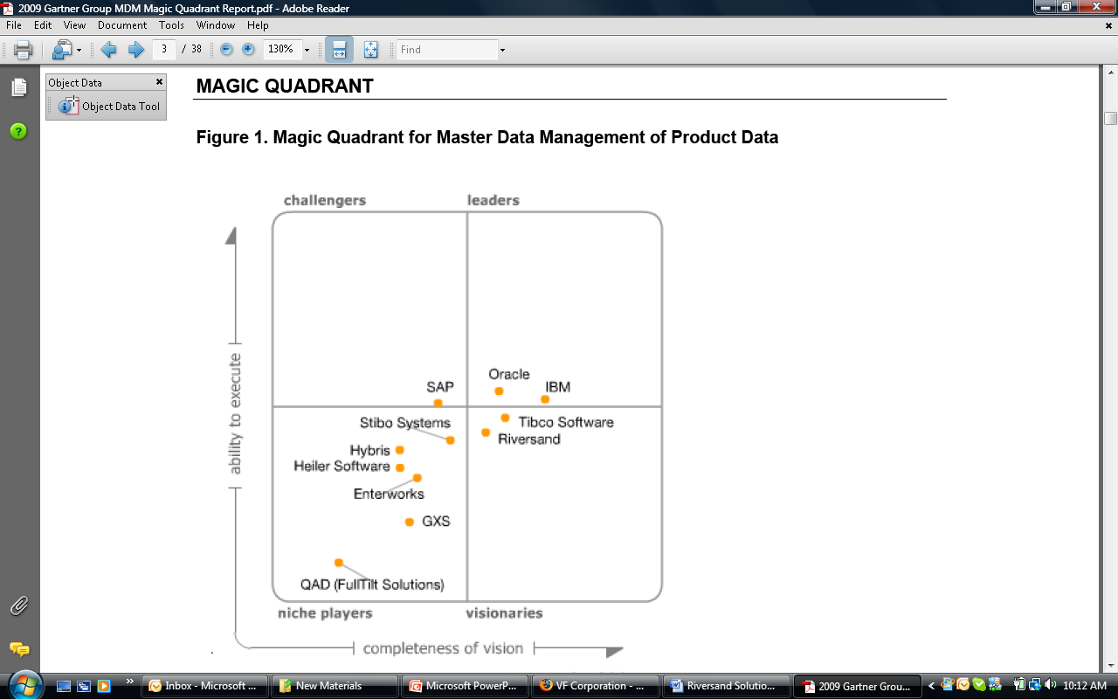
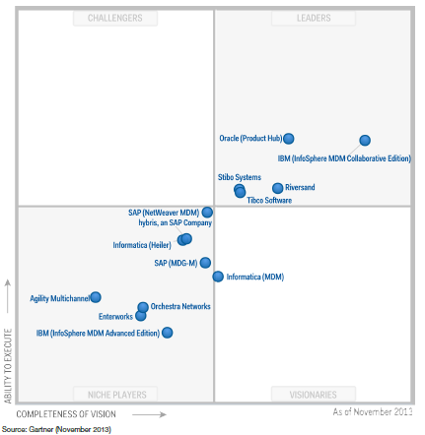
Riversand: the highest-rated pure-play MDM provider
Riversand established as the most innovative company in the “Leaders” Quadrant
Gartner’s MQ report highlights Riversand's strengths:
Business Strategy
Market Growth/Momentum
“Leader" functionality and product strategy
References and customer base
Solid partner program
2012
2011
2010
2009

Slide 3
Build Vs Buy – What is good? (Please change the title)
Notes:
Please add the rationale of why NFP should go for Buy and not Build their MDM solution

Slide 4
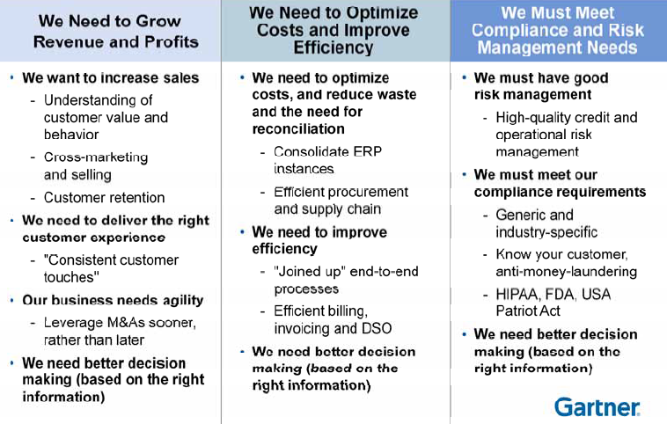
Linking MDM initiatives to Business Value (to be updated)
Notes:
1. This slide needs to be made relevant to NFP’s business and benefits

Slide 5
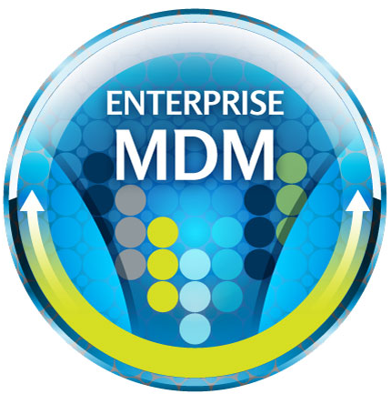

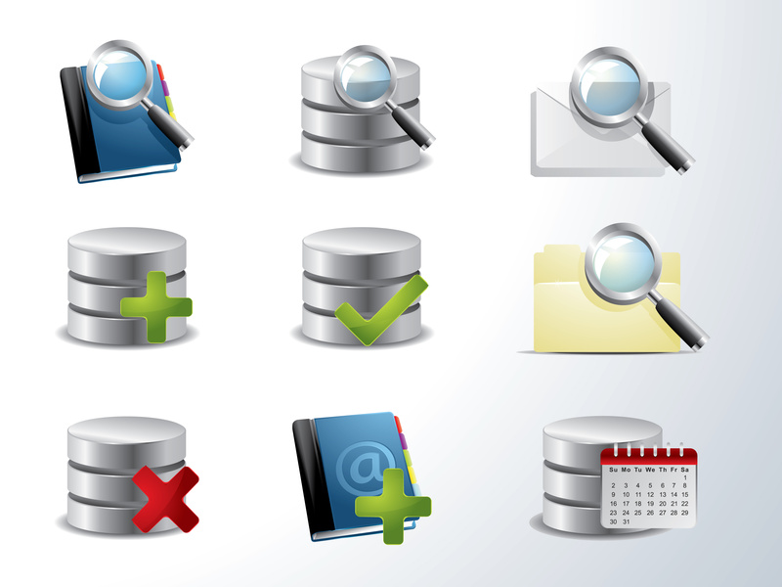


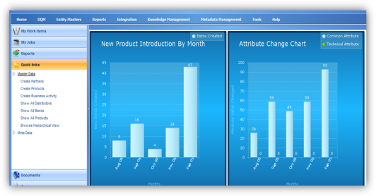

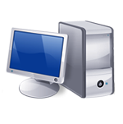

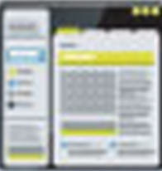



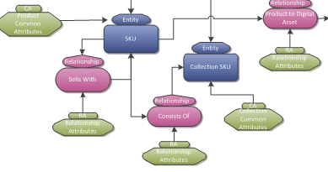
Riversand’s solution fully enables multi-domain MDM (To be Updated)
PRODUCT
ASSET
Data
Globalization
Entity
Explorer
CUSTOMER
LOCATION
Reporting &
Analysis
Workflow
VENDOR
Matching &
Merging
Performance &
Scalability
Data
Governance
Data
Integration
Relationship
Management
Flexible
Data Model
Notes:
Please add NFP domains and make it relevant. Following are NFP domain:
Firm
Region
Product
Producer
Employee
Carrier
Client
Vendor

Slide 6
Use Case # 1 Integrated view of customer investments across three lines of NFP business (To be Added)
Notes:
Please fill this slide with the below use case:
· Building an integrated view of customer investments across three lines of NFP business (wealth management, insurance, benefits etc) with data from potentially 5-6 different data sources

Slide 7
Use Case # 2: Cross selling other financial products ( To be addded)

Slide 8
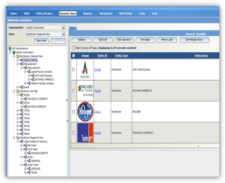
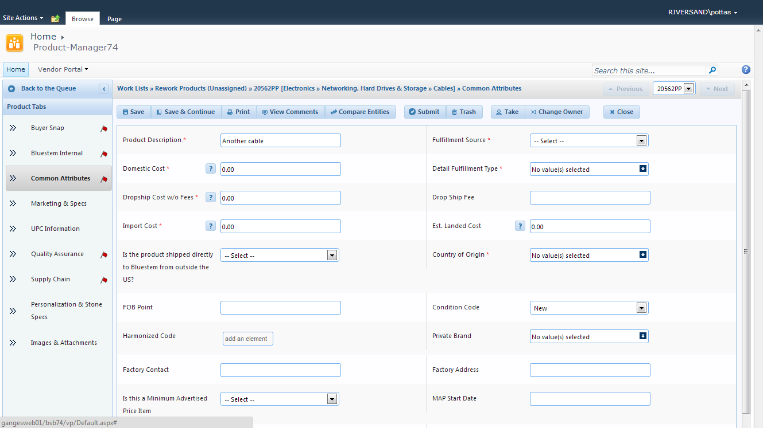
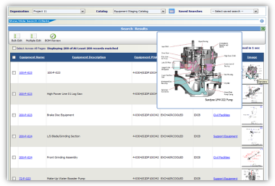
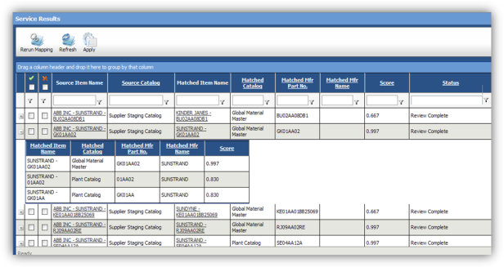
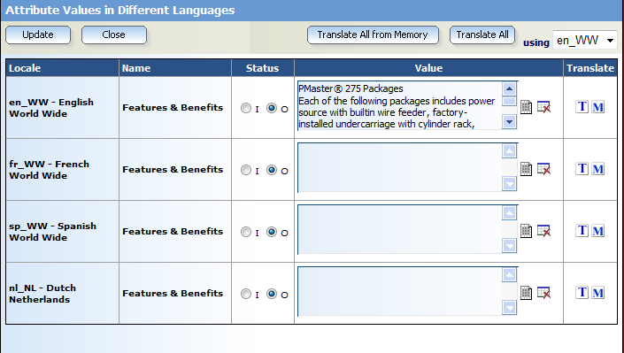
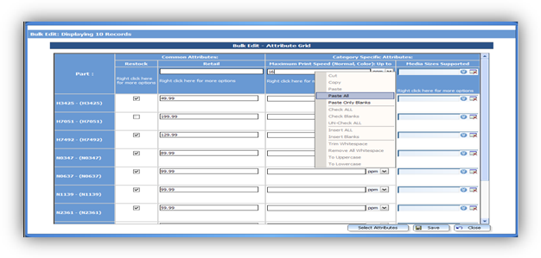
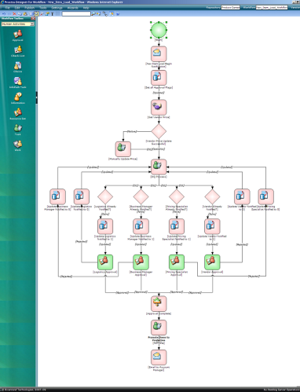
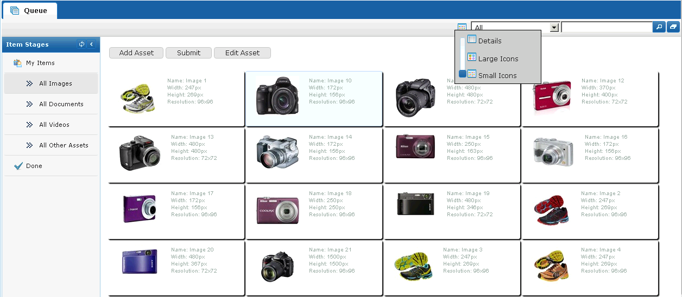
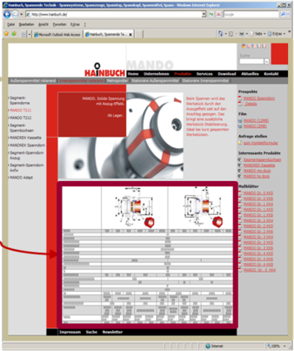
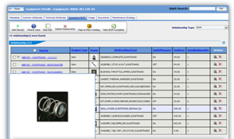
MDMCenter Solution Overview(To be Updated)
Data Views
Vendor Portal
Reporting
Advanced Search
Data Quality Management
Data Globalization
Productivity Tools
BPM & Workflow
Digital Asset Management
Print Publishing
Relationship Management
Notes:
Please update this slide to NFP’s needs, if possible.

Slide 9



Examples of Riversand’s Multi-domain MDM clients
World’s Largest Generic Pharmaceutical Manufacturer. Managing Materials, Recipes, Product, and Vendor Master Data.
World’s Largest Apparel Manufacturer. Chose MDMCenter to Manage Vendor, Customer and Product Master Data across 32 brands globally.
A global healthcare company with expertise in medical devices, pharmaceuticals and biotechnology. Selected Riversand for Vendor data management and will be expanding to include other domains.

Slide 10
Thank you!

